Slide 1
Engineering Mechanics Course code: 116U06C104
Module 4: Equilibrium
Lecture : Introduction to equilibrium of system, types of supports & loads

Slide 2

Learning Outcomes
Lect 21: At the end of lecture learner will be able to draw free body diagram for the given system of forces.
Lect 22: At the end of lecture, learner will be able to calculate support reactions using conditions of equilibrium for beams.

Slide 3
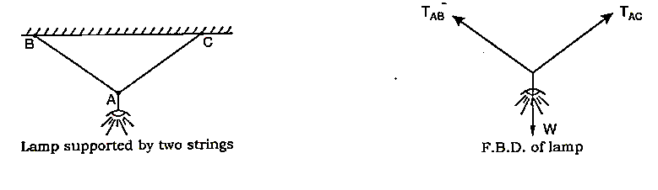
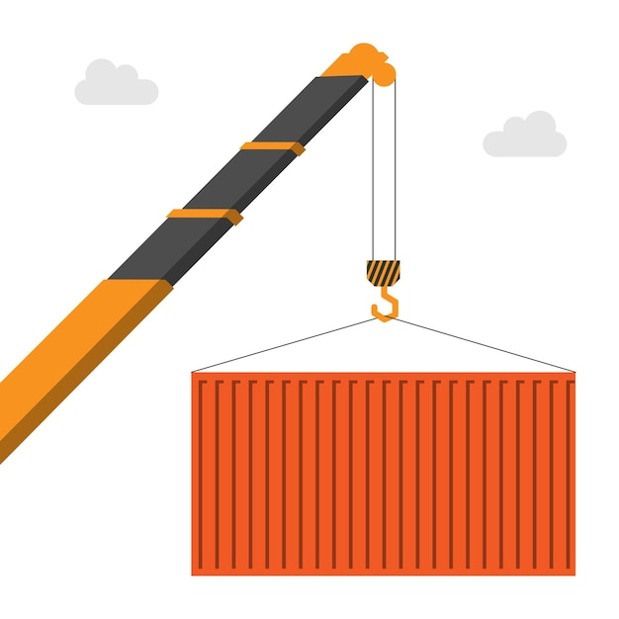
Introduction
A lamp hanging from the ceiling is an example of concurrent Force System in equilibrium.
Structures like buildings, dams etc. are examples of General Force System in equilibrium.
Students sitting on a bench is an example of parallel Force system in equilibrium.

Slide 4
Equilibrant
A force which is equal, opposite and collinear to the resultant of a concurrent force system

Slide 5
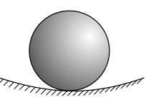
Types of Equilibria
Stable Equilibrium
A body is said to be in a stable equilibrium if
It is initially in a state of static equilibrium
and
On giving a slight displacement an additional
force is set up which tends to restore the
original position of the body.
Fig. 1 A body in a stable equilibrium[^{1]}

Slide 6
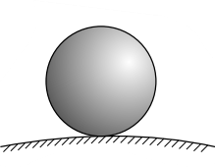
Unstable Equilibrium
A body is said to be in a unstable equilibrium if
It is initially in a state of static equilibrium
an additional force is setup on a slight displacement which tends to push it away from the original position of the body and
it does not return back to its original position after being slightly displaced by a force
Fig. 2 A body in an unstable equilibrium[^{1]}
Types of Equilibria Cont..

Slide 7
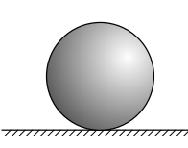
Neutral Equilibrium
A body is said to be in a neutral equilibrium if
it is initially in a state of static equilibrium,
no additional force is setup on a slight displacement from initial position and
it occupies a new position and remains in static equilibrium in this new position.
Types of Equilibria Cont..

Slide 8
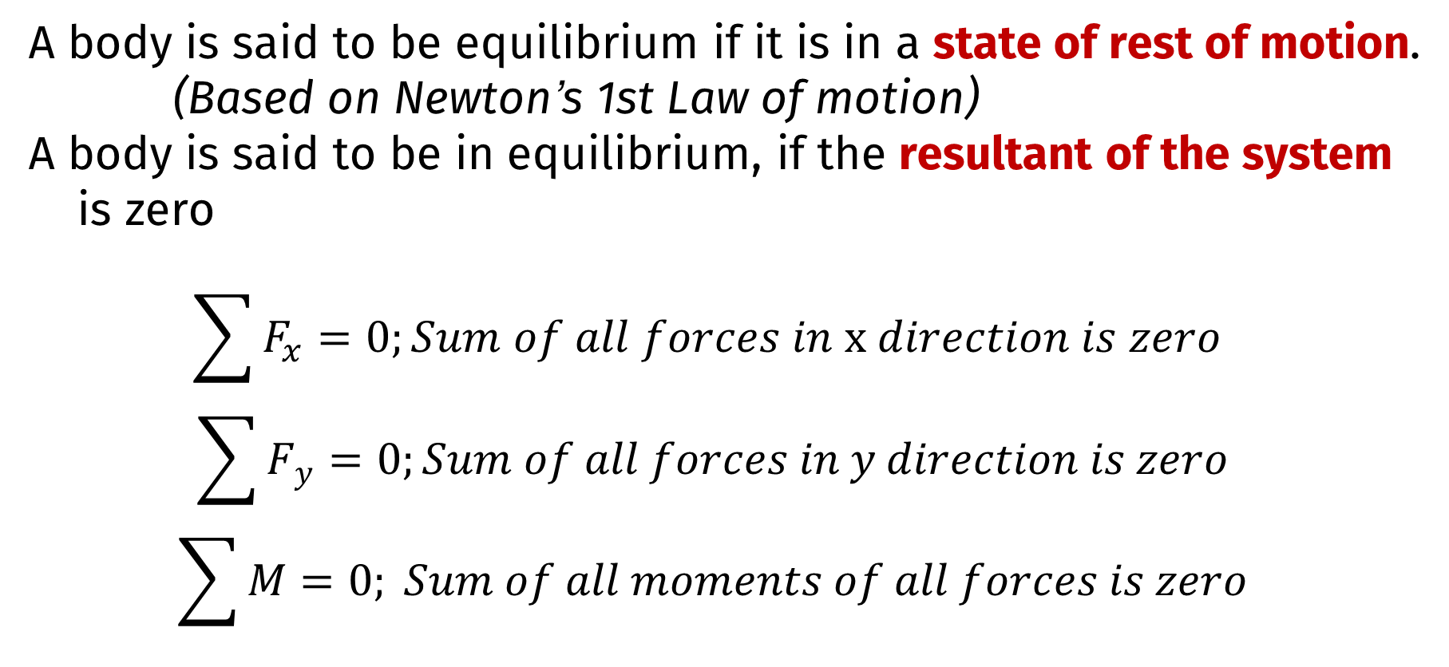
Conditions of Equilibrium
A body is said to be equilibrium if it is in a state of rest of motion.
(Based on Newton’s 1st Law of motion)
A body is said to be in equilibrium, if the resultant of the system
is zero
$$\sum{F_{x}=0;Sum of all forces in x direction is zero}$$
$$\sum{F_{y}=0;Sum of all forces in y direction is zero}$$
$$\sum{M=0; Sum of all moments of all forces is zero}$$

Slide 9
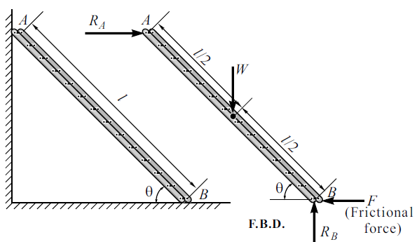
Free Body Diagram (FBD)
A diagram formed by isolating the body from its surroundings and the showing all the forces acting on it is known as a Free Body Diagram
Fig. 4 Ladder resting against a smooth wall^{[2]}

Slide 10
Free Body Diagram (FBD)
Fig. 5 Lamp suspended from two strings tied to a ceiling^{[2]}
Free Body Diagram Cont..

Slide 11
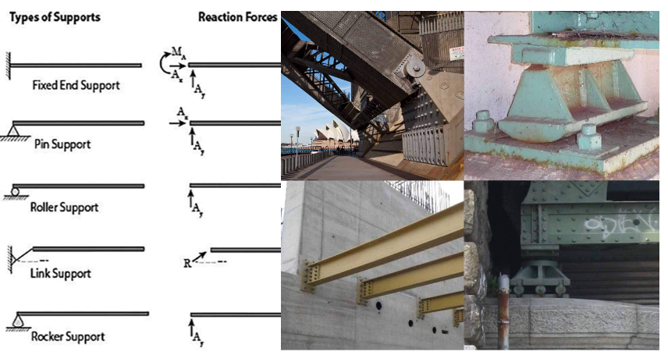
Types of Supports

Slide 12
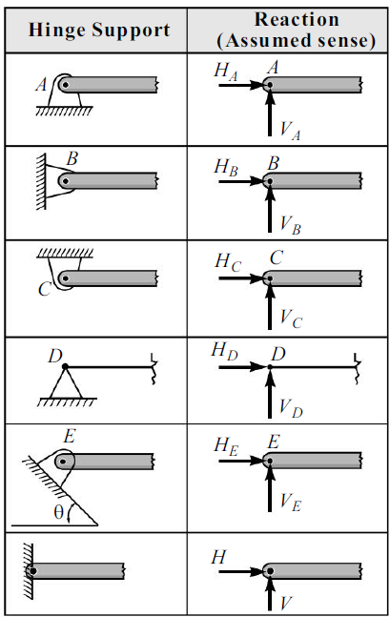
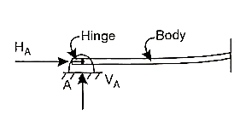
Types of supports & Reactions
Whenever a body is supported, the support offers resistance, known as reaction
Hinge Support
A hinge allows free rotation of the body but does not allow the body to have any linear motion.
It offers a force reaction which can be split: horizontal and vertical components
Fig. 6 Hinge Support^{[2]}
Types of Supports Cont..

Slide 13
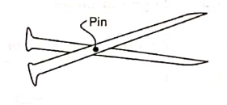
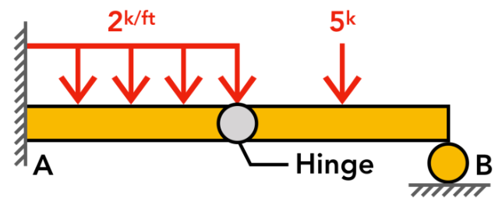
Hinge Support
A special case of Hinge Support: Internal Hinge or pin connection
When a two bodies are connected such that the connection allows rotation between the parts, and behaves as an hinge
Fig. 7 Scissors connected by a pin^{[2]}
Types of Supports Cont..

Slide 14
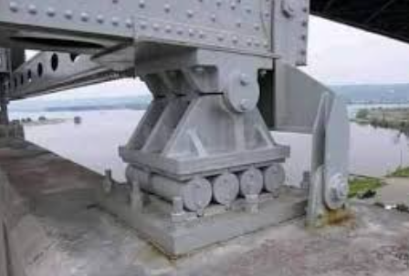
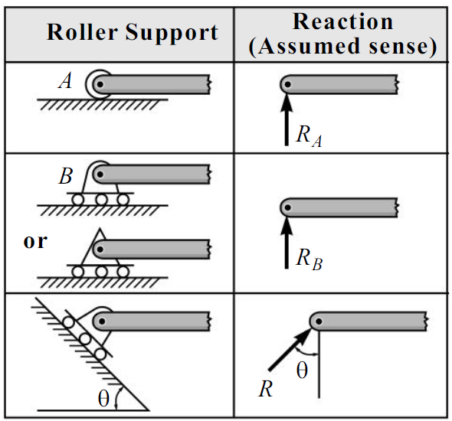
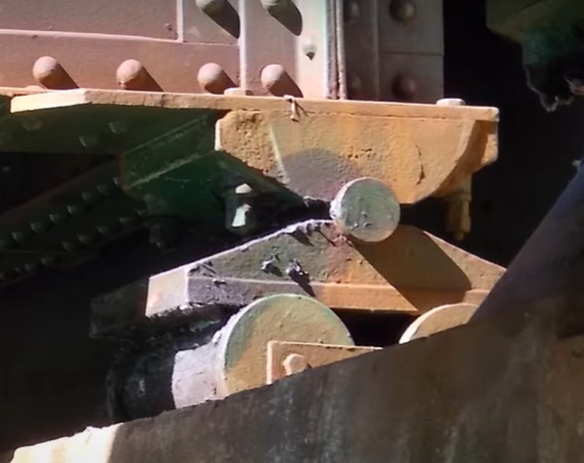
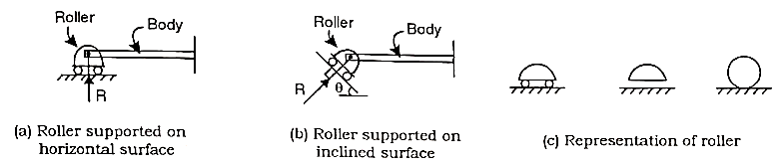
Roller Support
A roller support is free to roll on a surface on which it rests. It offers a forces reaction in a direction normal to the surface on which the roller is supported.
Fig. 8 Roller Support representation^{[2]}
Types of Supports Cont..

Slide 15
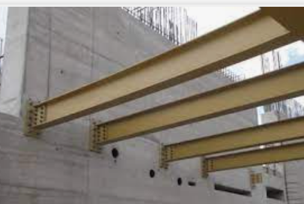
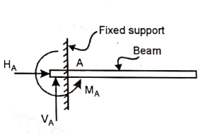
Fixed Support
A fixed support neither allows any linear motion nor allows any rotation.
It therefore offers a forces reaction which can be split into a horizontal and a vertical reaction component and also a moment reaction.
Types of Supports Cont..

Slide 16
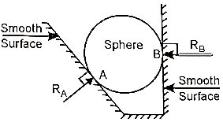
Smooth Surface Support
Offers similar reaction as a roller support
A force reaction normal to the smooth surface.
Fig. 10 Smooth surface Support representation^{[2]}
Types of Supports Cont..

Slide 17
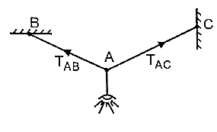
Rope/string/cable Support
It offers a pull force in a direction away from the body.
This force is commonly referred to as the tension force.
Fig. 11 Lamp suspended by a two strings^{[2]}
Types of Supports Cont..

Slide 18
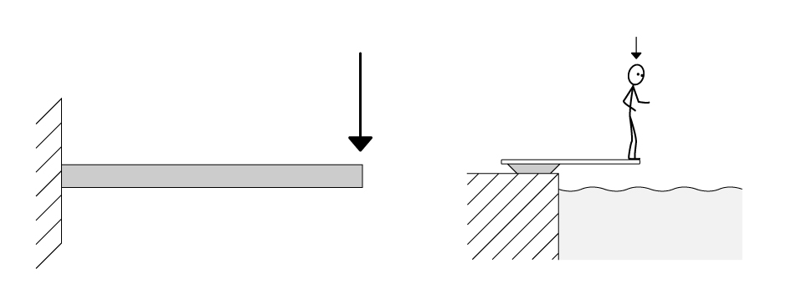
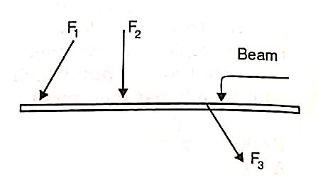
Types of loads
Point Load
Fig. 12 Beams loaded with point load^{[2]}

Slide 19
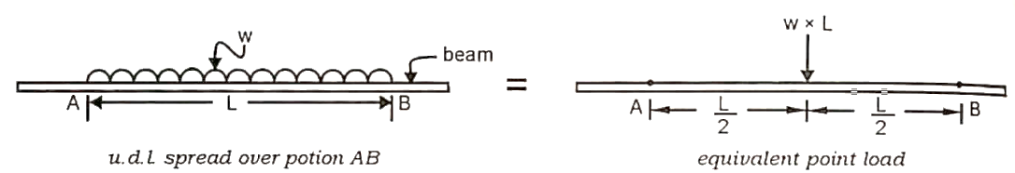
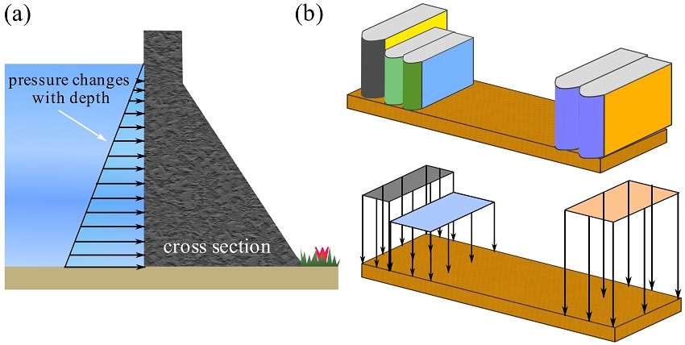
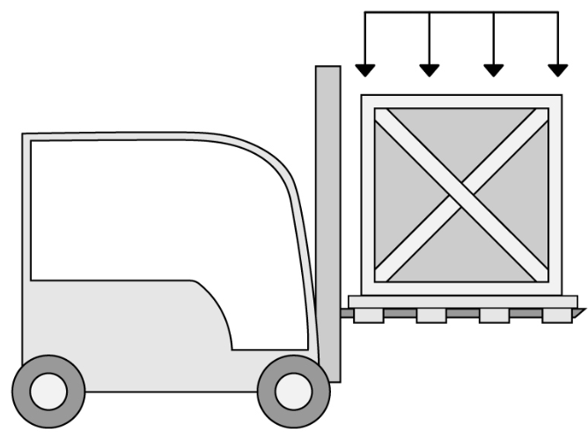
Uniformly distributed load (U.D.L.)
Types of loads Cont..

Slide 20
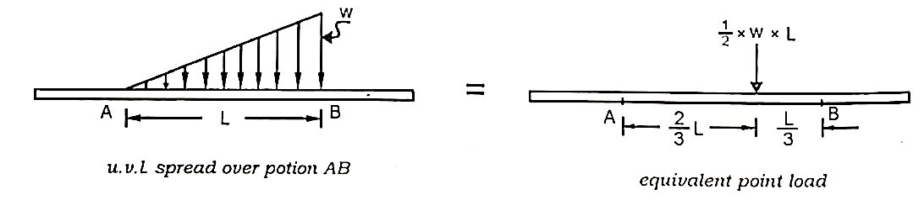
Types of loads
Uniformly varying load (U.V.L.)
Fig. 14 Beams loaded with u.v.l.^{[2]}
Types of loads Cont..

Slide 21
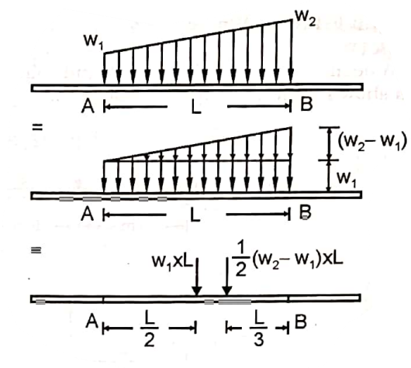
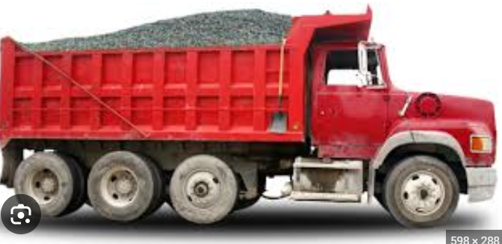
Trapezoidal load
Fig. 15 Beams loaded with trapezoidal load^{[2]}
Types of loads Cont..

Slide 22
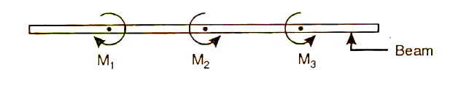
Types of loads
Couple load
Fig. 16 Beams loaded with couple load^{[2]}
Types of loads Cont..

Slide 23
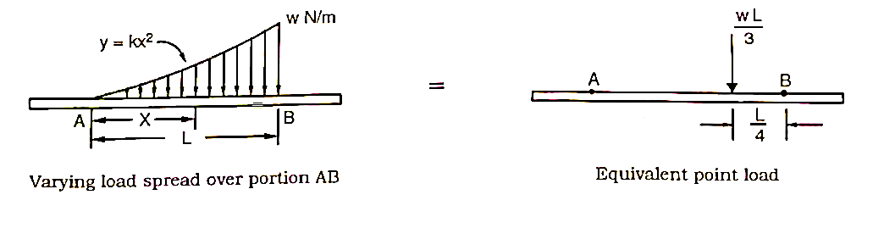
Types of loads
Varying load
Fig. 17 Beams loaded with couple load^{[2]}
Types of loads Cont..

Slide 24
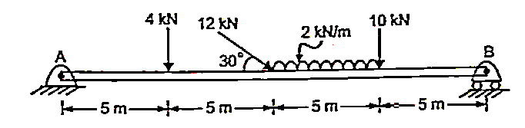
Equilibrium of single body Numerical
Q. 1 A beam is hinged at end A and roller supported at end B. It is acted upon by loads as shown. Determine the support reactions. (Ans. Ra = 16.06 kN, 49.69° Rb = 17.75 kN)
Fig. 18 Beams loaded with point load and u.d.l^{[2]}

Slide 25
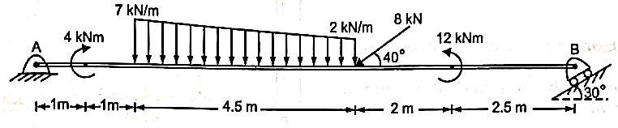
Q. 2 A beam AB is loaded by forces and couples as shown. It is acted upon by loads as shown. Determine the support reactions to keep the system in equilibrium (HA = 11.54, Va = 16.02, Rb = 10.82, 60⁰)
Fig. 19 Beams loaded with point, couple load and trapezoidal load^{[2]}
Numerical on Equilibrium of single body Cont..

Slide 26
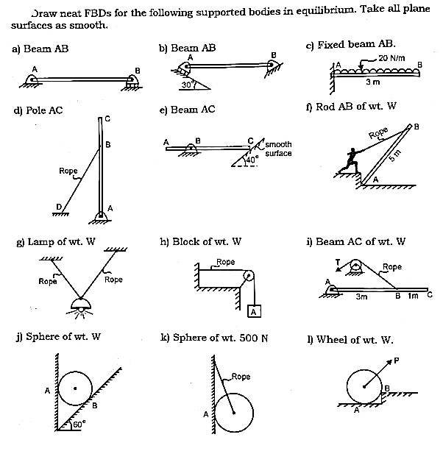
Q. 3) Draw F.B.D. for the following supported bodies in equilibrium. Take all plane as smooth
Fig. 20 Bodies for F.B.D. ^{[2]}
Numerical on FBD Cont..

Slide 27

Q. 4) Draw F.B.D. for the following supported bodies in equilibrium. Take all plane as smooth
Fig. 21 Bodies for F.B.D. ^{[2]}
Numerical on FBD Cont..

Slide 28
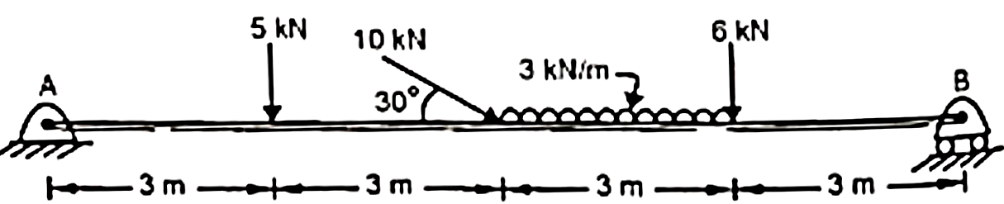
Q. 5) A beam AB is loaded as shown. Determine the support reactions.
Fig. 22 Beam loaded with point load and u.d.l. ^{[2]}
Numerical on Equilibrium of single body Cont..

Slide 29
Engineering Mechanics, N. H. Dubey, Mc Graw Hill Education (India) Pvt. Ltd.
Engineering Mechanics, M. D. Dayal, page no. 41 to 55.

